Slide 1
Sleep mode: conceptions of energy in discourses of workism
Dr. Cressida J. Heyes
Professor and HM Tory Chair, University of Alberta
cheyes@ualberta.ca
www.cressidaheyes.com

Slide 2
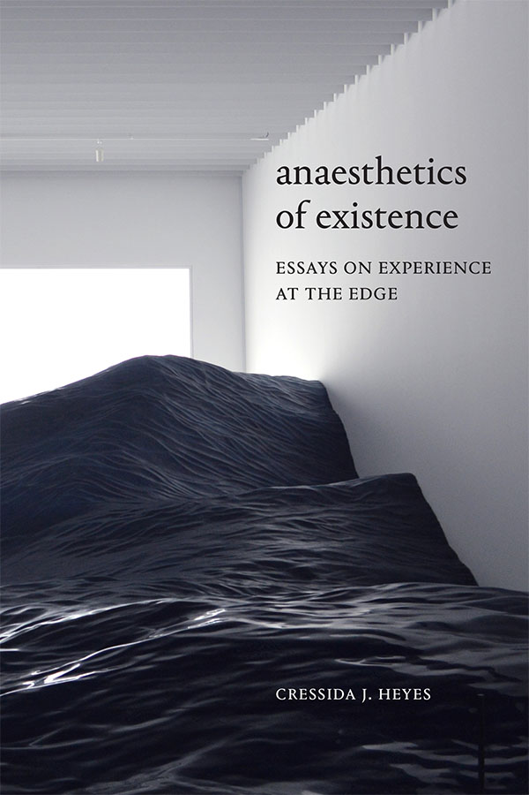
Notes:
An even more radical feminist gesture: what if we don’t need to have any projects at all? What about the experience of time that is utterly uninvested in generativity beyond its own experience? In my book I explore this through the idea of anaesthetic time.

Slide 3
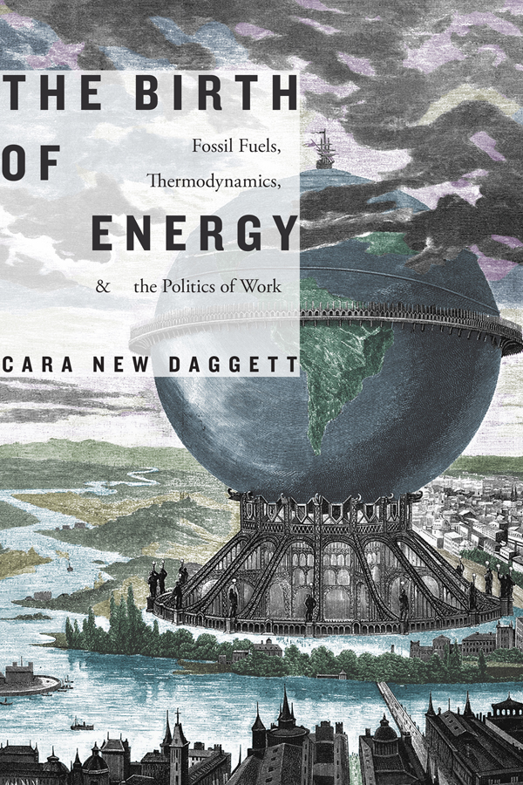

Slide 4
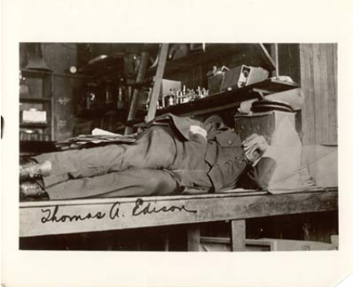
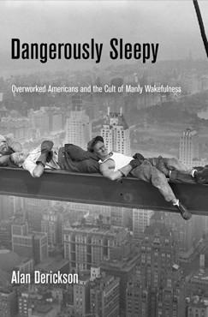
The sleep-negative entrepreneur
Notes:
Sleeping subject is not working or accumulating human capital
The sleep-deprived, overworking subject is an elite, masculine entrepreneur

Slide 5
The sleep-positive entrepreneur
“People are not machines…For machines... downtime is a bug; for humans, downtime is a feature. The science is clear.”
“Tesla is revolutionary because it’s all about how we can most efficiently use energy, which holds the potential to change the world... But ...you’re demonstrating a wildly outdated, anti-scientific and horribly inefficient way of using human energy.”
“Elon, the future of Tesla depends on you coming up with your masterpiece. It doesn’t depend on how many hours you’re awake. Tesla—and the world (not to mention you and your beautiful children)—would be better off if you regularly built in time to refuel, recharge and reconnect with your exceptional reserves of creativity and your power to innovate. Working 120-hour weeks doesn’t leverage your unique qualities, it wastes them.”
Arianna Huffington’s open letter to Elon Musk, 2018

Slide 8
Sleep mode: conceptions of energy in discourses of workism
Dr. Cressida J. Heyes
Professor and HM Tory Chair, University of Alberta
cheyes@ualberta.ca
www.cressidaheyes.com

Slide 9
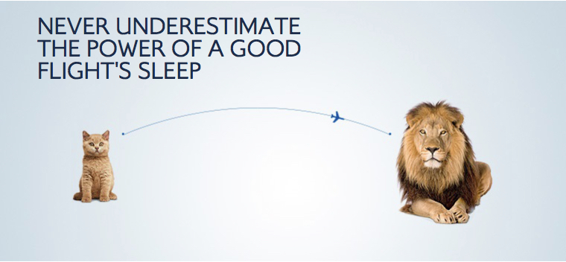

Slide 10
